Slide 1

Name: Srijeeta Saha
Institute: Ivy Professional School
Welcome to Fusion Flavors, a newly opened restaurant that celebrates the best of diverse cuisines, from Italian and Mexican to American and Asian delights. In just three months, Fusion Flavors has drawn in a vibrant crowd, each bringing unique preferences and tastes. As we dive into sales and order trends, we're gaining insights into which dishes are favorites, what flavors captivate returning customers, and how to elevate the dining experience.

Slide 2
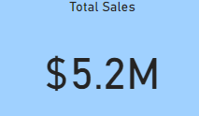
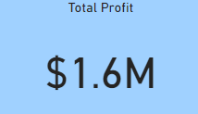
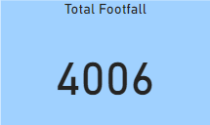
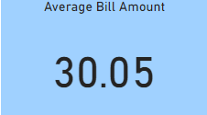
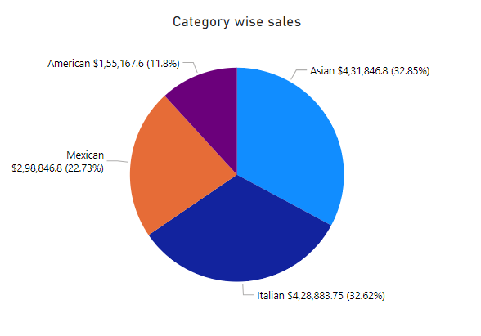
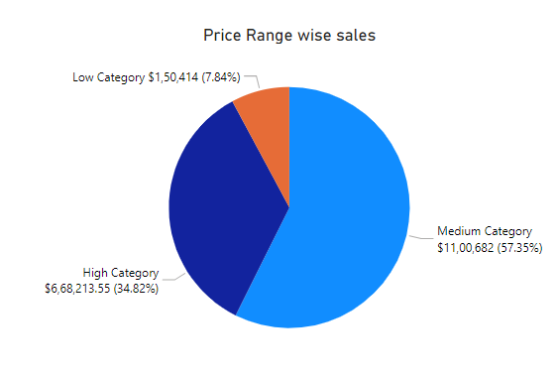
Fusion Flavors Sales Analysis
Items priced below $10: Low Category
Items priced between $10 and $15: Medium Category
Items priced above $15: High Category

Slide 3
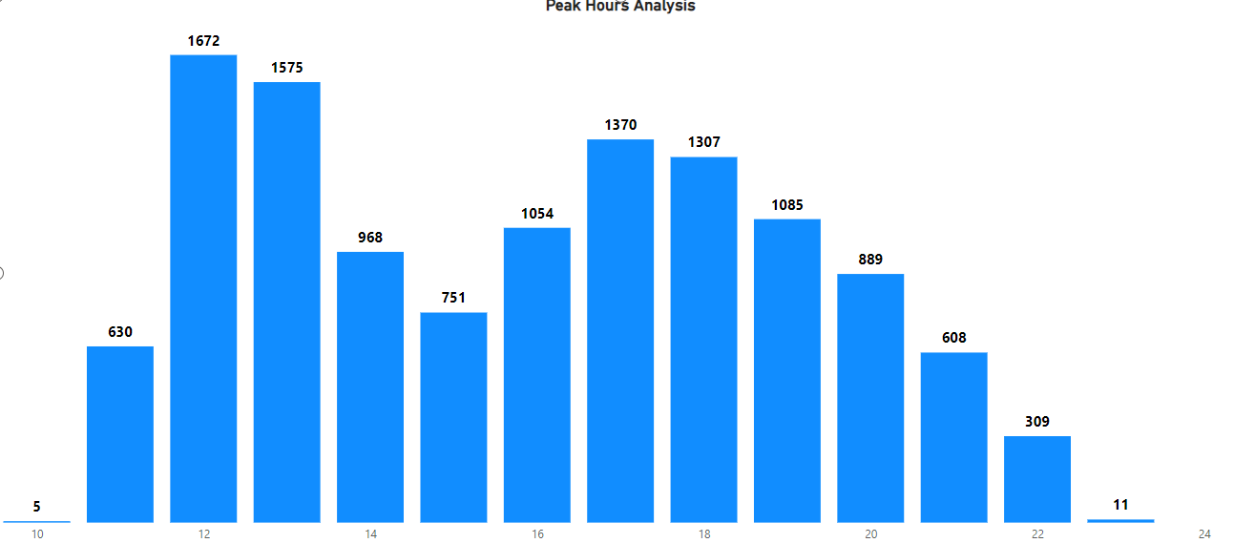
Peak Hours Analysis
12 PM peak time: Highest order count.
1 PM remains strong: Second highest order activity.
Late night decline: Drastic drop after 9 PM.
Afternoon slump: Orders decrease after 1 PM.
Dinner recovery: Moderate order increase around 5-7 PM.
Minimal early orders: Very few at 10 AM.
Actionable insights:
Promote lunch specials: Focus on 12-1 PM.
Boost afternoon snacks: Encourage 2-4 PM engagement with discounts.
Offer evening deals: Dinner offers between 5-7 PM.
Highlight late-night items: Promote for post-8 PM orders.
Reduce staff post-9 PM: Lower demand reduces staffing needs.

Slide 4
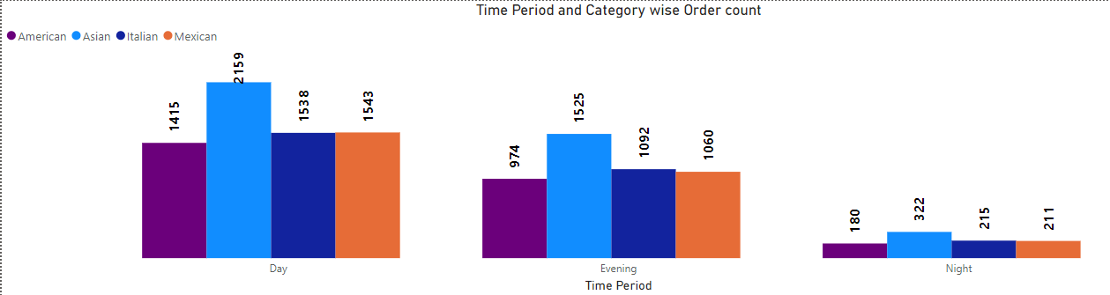
Order count based on Time period and Category
American Cuisine: Steady daytime demand.
Asian Cuisine: Highest demand at lunchtime.
American Cuisine: Slightly higher evening orders.
American Cuisine: Significant drop-off at night.
Asian Cuisine: High evening popularity.
Italian Cuisine: Moderate lunch demand.
Asian Cuisine: Consistent night-time interest.
Italian Cuisine: Slightly lower in evening.
Italian Cuisine: Low late-night interest.
Mexican Cuisine: Consistent lunch and dinner orders.
Mexican Cuisine: Lower demand at night.
Actionable insights:
For Asian Cuisine Lovers: Promote lunch and dinner specials. Consider late-night Asian menu options.
For American Cuisine Fans: Highlight evening American deals. Limit late-night American offerings.
Italian & Mexican Cuisine Promotion: Boost lunch and dinner deals. Limit night menu for efficiency.
General Preparation: Increase staffing for lunch, dinner. Stock up for peak hours. Ensure popular items readily available.

Slide 5
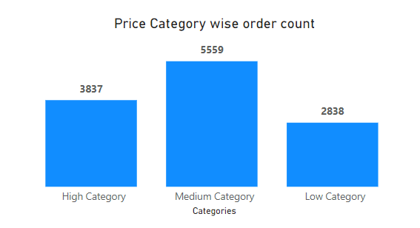

Price Category wise order Count
High-end items moderately favoured.
Medium-priced items drive sales.
Opportunity for mid-tier variety.
Low-priced items retain niche.
Customer preference toward affordable options
Actionable insights:
High-Category Focus: Target premium diners with promotions.
Medium-Category Expansion: Introduce seasonal dishes.
Low-Category Strategy: Offer as add-ons or combos.
Customer Retention: Rewards for repeat mid-tier buyers.
Pricing Strategy: Focus on mid-range appeal.

Slide 6
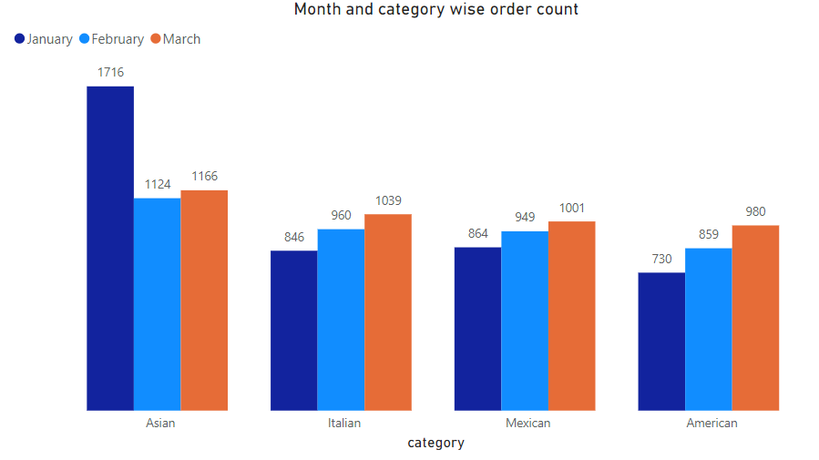
Month and Category wise order Count
Asian: January leads with 1716.
Italian: March sees 1039 orders, highest.
Mexican: March reaches 1001 orders.
American: March has 980 orders, highest.
Trends: Asian declines; Italian, Mexican grow.
Actionable insights:
Asian: Promote winter specials to boost January sales.
Italian: Launch new dishes to maintain growth momentum.
Mexican: Introduce promotional offers in peak months.
American: Leverage seasonal events for increased visibility.

Slide 7
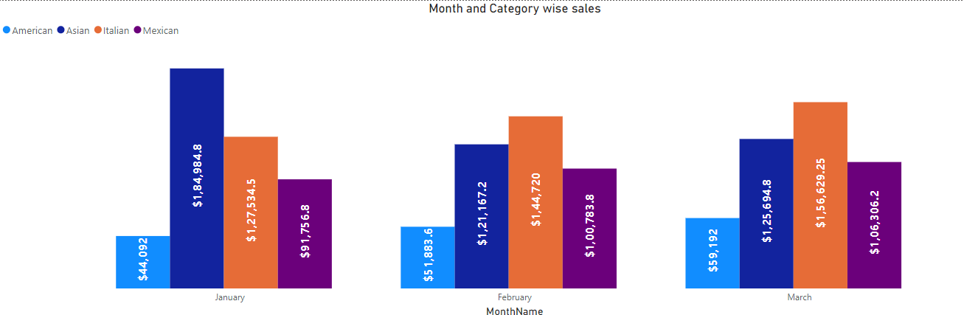
Category wise Sales Monthly Analysis
Asian Cuisine: January peaks at $184,984.8.
American Cuisine: Lowest sales in January (44092).
Italian Cuisine: February's high at $144,720.
Mexican Cuisine: Steady growth, March at 106306.2.
Sales Trend: Asian declining; Italian fluctuating.
Actionable insights:
Asian Cuisine: Introduce promotions to reinvigorate sales after January’s high.
American Cuisine: Revamp menu pricing or offerings to enhance appeal; consider bundle deals.
Italian Cuisine: Continue leveraging its popularity; promote seasonal dishes for sustained sales growth.
Mexican Cuisine: Expand marketing efforts and specials to capitalize on growing interest (106306.2 in March).
Pricing Strategy: Analyze competitor pricing; adjust based on customer feedback and sales performance to optimize revenue across all categories.

Slide 8
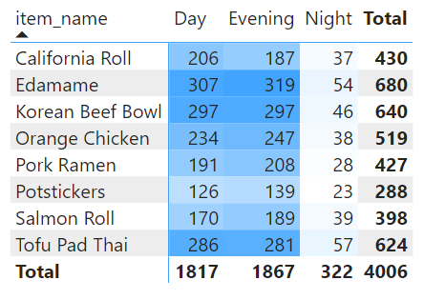
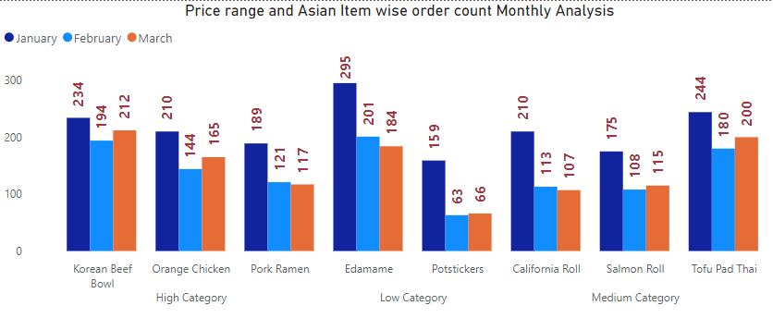
Asian Downhill Sales Analysis
Korean Beef Bowl: Highest in January at 234.
Orange Chicken: Sales drop to 144 in February.
Pork Ramen: 189 sold in January, lowest in March.
Edamame: 295 sold in January, declined to 184.
Potstickers: Significant drop from 159 to 63.
California Roll: Peaks at 210, lowest in March at 107.
Salmon Roll: Fluctuating sales, 175 highest in January.
Tofu Pad Thai: 244 sold in January, needs marketing boost.
Actionable insights:
Promote Strong Night Sellers: Edamame & Tofu Pad Thai: Leverage as late-night snacks.
Bundle Low Demand Items: Potstickers & California Roll: Offer combo discounts in February.
Evening Promotions: Highlight popular items like Edamame and Orange Chicken to maximize sales.
Nighttime Light Menu: Offer a “Late-Night Light” menu focusing on lighter options like Edamame and Tofu Pad Thai.
Actionable insights:
Strategic Inventory Management: Stock Edamame & Potstickers lightly in February.
Push January Specials: Promote Korean Beef Bowl, Orange Chicken aggressively in January.
Highlight Evening Favorites: Korean Beef Bowl & Edamame: Feature in evening meal deals.
Target Marketing by Seasonality: Emphasize Pork Ramen & Salmon Roll in winter specials for January.

Slide 9
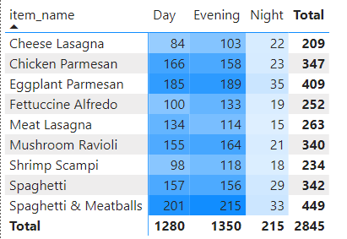
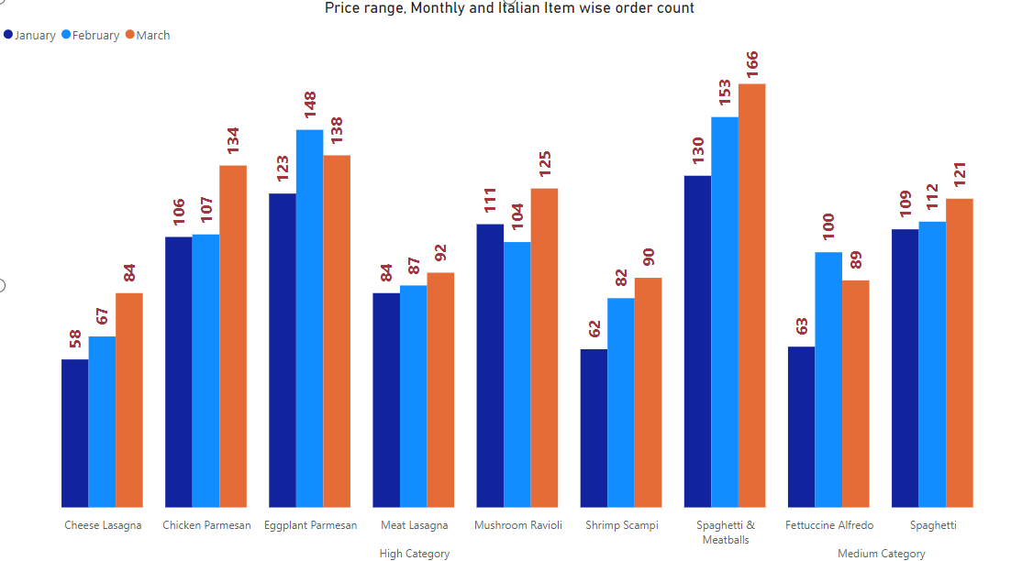
Italian Items Sales Analysis
Cheese Lasagna: Sales rose from $899 to $1302; orders increased from 58 to 84.
Chicken Parmesan: Consistent sales above $1,900; orders grew from 106 to 134.
Eggplant Parmesan: Fluctuating sales, peaked in February at $2508.6; orders increased from 123 to 138.
Meat Lasagna: Gradual sales growth; consistent order count increase from 84 to 92.
Shrimp Scampi: Sales peaked in February; stable orders suggest room for promotion.
Spaghetti and Meatballs: Strong sales growth; orders surged from 130 to 166.
Fettuccine Alfredo: Sales peaked in February; stable orders but potential for improvement.
Spaghetti: Consistent growth; orders increased from 109 to 121.
Mushroom Ravioli: Variable sales; increased orders from 111 to 125.
Actionable insights:
Promote High Evening Favorites: Chicken Parmesan & Eggplant Parmesan: Highlight as evening specials.
Bundle Low Night Demand Items: Shrimp Scampi & Fettuccine Alfredo: Promote for early dining specials.
Boost March Items for Consistency: Push Cheese Lasagna & Meat Lasagna in early March.
Actionable insights:
Monthly Specials Based on Growth Trends: Spaghetti and Meatballs in March: Market heavily in all time periods.
Target January Promotions: Emphasize Mushroom Ravioli & Eggplant Parmesan in January offers.
Adjust Inventory for Demand Growth: Increase Fettuccine Alfredo stock in February.
Attract Evening Diners: Feature Chicken Parmesan, Mushroom Ravioli prominently for dinner.

Slide 10
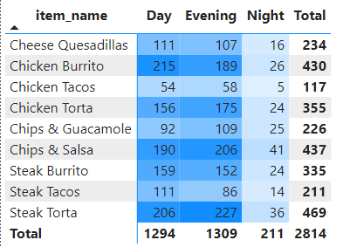
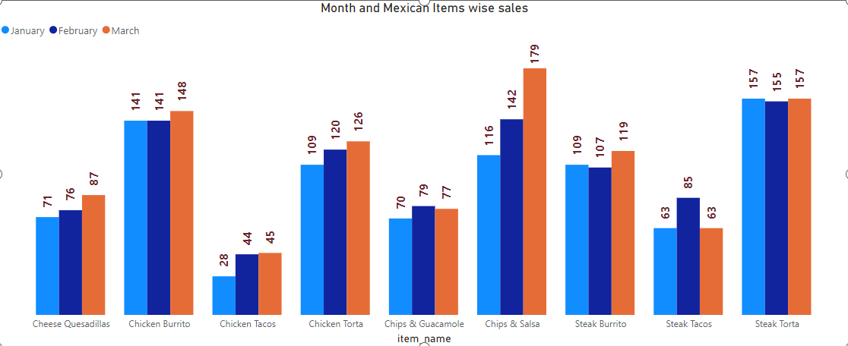
Mexican Items Sales Analysis
Chips and Guacamole: Slight fluctuation; peak in February. Low in January and steady through March.
Chips and Salsa: Strong upward trend, peaking in March. Significant demand rise across months.
Cheese Quesadillas: Highest demand in March. Gradual increase across months; low demand in January.
Chicken Burrito: Steady growth with peak in March. Constant demand from January to February.
Chicken Torta: Demand increases monthly, peaking in March. Solid rise from January to March.
Steak Burrito: Stable but modest rise with peak in March. Minimal fluctuation across months.
Steak Tacos: Consistent demand in January and March. February shows a notable increase.
Steak Torta: Highest in January and March, consistent across months.
Chicken Tacos: Minor growth over three months; remains consistently low.
Actionable insights:
Highlight Evening Specials for Torta Dishes: Promote Steak & Chicken Torta for dinner hours.
Boost Daytime Orders for Chips & Salsa: Run lunchtime specials on Chips and Salsa.
Leverage March Demand Increase: Feature Chicken Torta & Steak Burrito in early March promotions.
Encourage Night Dining for Low Items: Bundle Cheese Quesadillas and Burritos for nighttime deals.
Actionable insights:
Promote Chips & Salsa in March to capitalize on peak demand.
Bundle deals for low-demand items (e.g., Chicken Tacos) in January to increase sales.
Focus marketing on Chicken Burritos and Tortas for sustained growth across all months.
Introduce a “March Fiesta” with discounts on high-demand items like Cheese Quesadillas and Chicken Burritos.

Slide 11
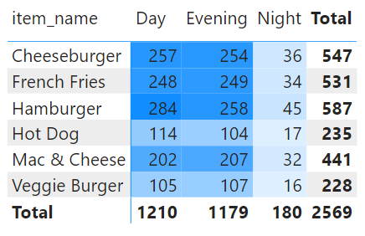
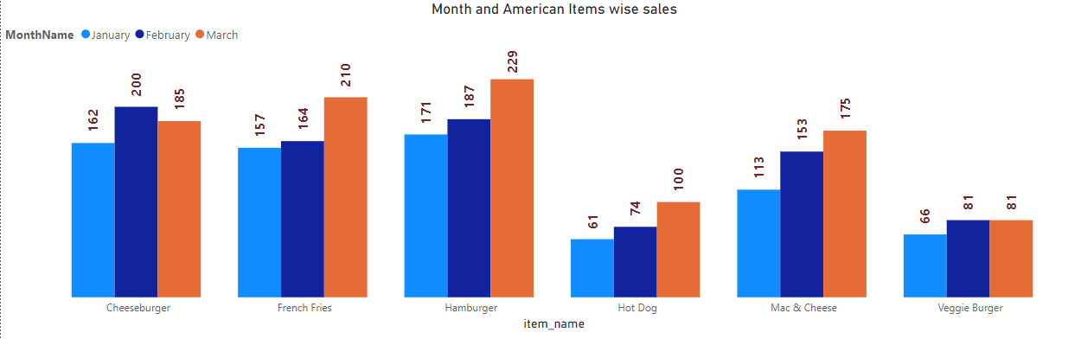
American Items Sales Analysis
French Fries: Highest in March; consistent growth each month. Moderate in January.
Mac & Cheese: March peak; February steady rise. January lowest demand.
Hot Dog: March sees peak interest. Consistent rise from January to March.
Hamburger: March peak sales; January second highest. Stable in February.
Veggie Burger: Consistent February and March sales. January demand notably low.
Cheeseburger: Strongest demand in February. January lowest sales; March stable.
Actionable insights:
Target March for Low Items: Promote French Fries & Mac & Cheese in March.
Capitalize on Daytime Demand for Hamburgers: Offer lunchtime specials on Hamburgers.
Encourage Night Orders for Low Items: Bundle Cheeseburgers and Hot Dogs for night deals.
Actionable insights:
Promote Hot Dogs and French Fries in March: Leverage peak sales month for cross-promotions.
Increase January Promotions: Target low-demand items like Mac & Cheese and Hot Dogs with discounts or combos.
Special February Cheeseburger Promotions: Drive growth by pushing the popular February item.
Bundle Veggie Burger with Popular Items: Boost Veggie Burger in January with French Fries or Mac & Cheese.

Slide 12
Actionable Insights
Seasonal Promotions: Introduce seasonal or themed promotions for high-demand items in peak months. For example, “Taco Tuesdays” for Mexican cuisine or spring-themed promotions for seafood in Italian dishes.
Combo Deals & Bundles: Leverage combo deals by bundling popular items (e.g., burgers with fries, burritos with sides). Family-style or group meal packages can also drive larger order volumes, especially for Italian and American cuisines.
Highlight Premium Items: For high-price category items like Korean Beef Bowl and Shrimp Scampi, use targeted marketing to emphasize their premium quality. Seasonal premium offerings or loyalty rewards can maintain interest.
Focus on Low-Price Leaders: Promote best-selling, low-priced items like French Fries and Edamame by featuring them in meal deals, combo packs, or as add-ons. This can drive consistent sales and cater to price-sensitive customers.
Promote Health-Conscious Options: Emphasize plant-based items like Tofu Pad Thai or Veggie Burger with targeted campaigns aimed at health-conscious diners. Expanding vegetarian offerings in medium-priced categories can attract a broader customer base.
Targeted Marketing for Demand Peaks: Use holidays and events (e.g., Super Bowl for American cuisine or Cinco de Mayo for Mexican) to launch special promotions, which can help boost sales for seasonal or culturally significant items.
Revitalize Low-Selling Items: For items with moderate demand, create variations or enhance appeal (e.g., flavored fries or gourmet Mac & Cheese). Running limited-time offers can reinvigorate customer interest.
Loyalty Programs for Retention: Implement loyalty rewards for popular items across price tiers, encouraging repeat purchases. For example, “buy 4, get 1 free” on frequently ordered burritos or burgers.
Boost February Engagement: Counter February’s lower demand with loyalty programs or post-holiday promotions. Valentine's Day and seasonal discounts can sustain customer interest.
Capitalize on March Demand: Given March’s strong sales across multiple categories, plan increased inventory and staffing. Limited-time discounts or spring-themed offerings can maximize revenue.

Slide 13


